Slide 1

제42강 웹뷰(WebView)를 이용한 웹페이지 보기
웹뷰의 원리
웹뷰를 이용한 웹페이지 출력

Slide 2
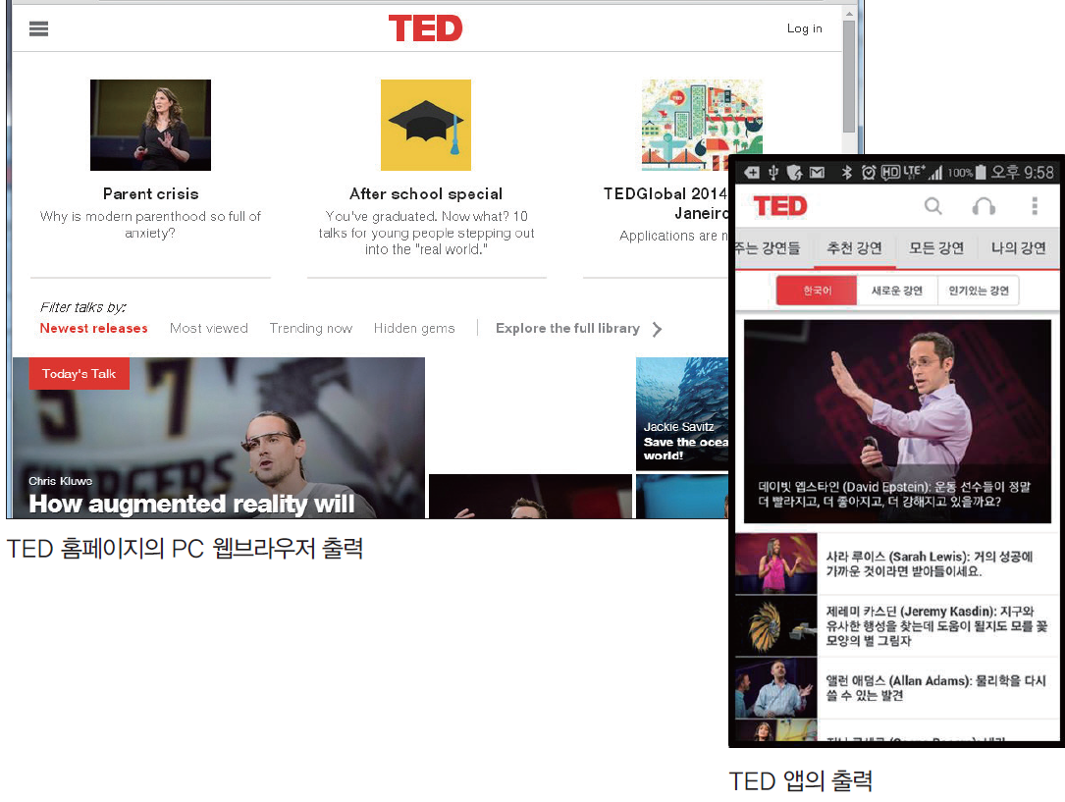
웹페이지 출력의 원리
(1) 웹페이지 출력의 예
디바이스 종류에 따른 웹페이지 출력

Slide 3
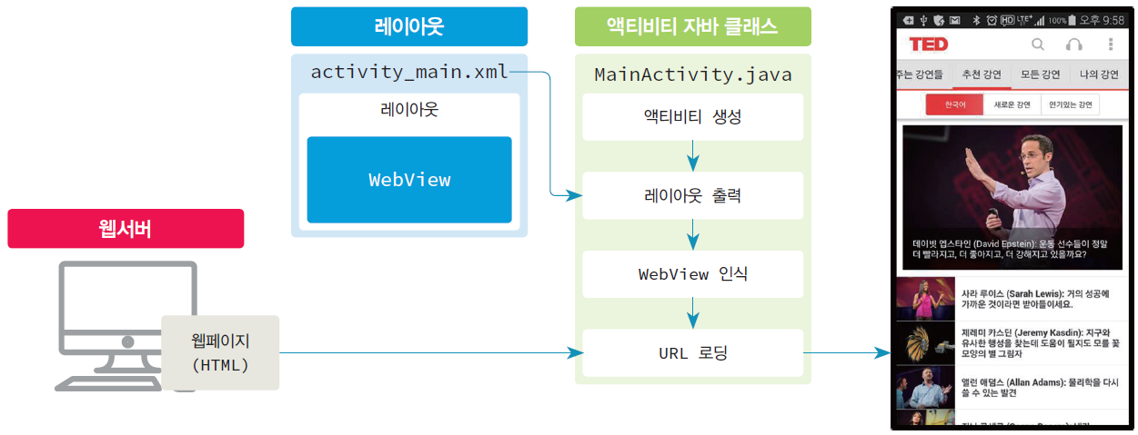
(2) 웹페이지 출력 원리
○ 웹서버로부터 다운로드 받은 HTML 기반의 웹페이지를 WebView 클래스를 이용하여 웹브라우저와 같은 형식으로 출력

Slide 4
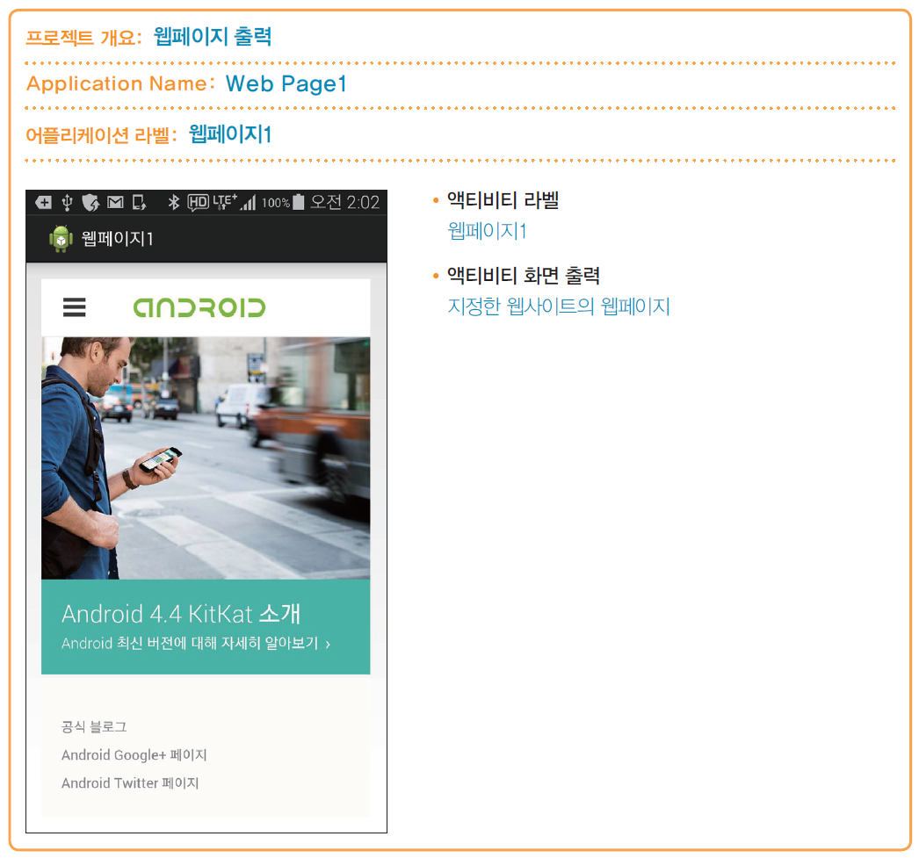
웹뷰를 이용한 웹페이지 출력
Web Page 프로젝트
프로젝트 개요
: 웹페이지 출력

Slide 5
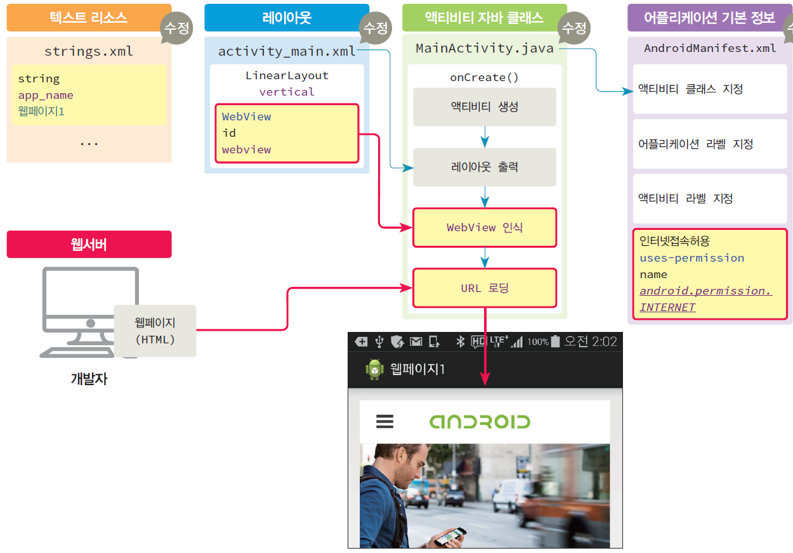
기본 파일 간의 연관관계

Slide 6
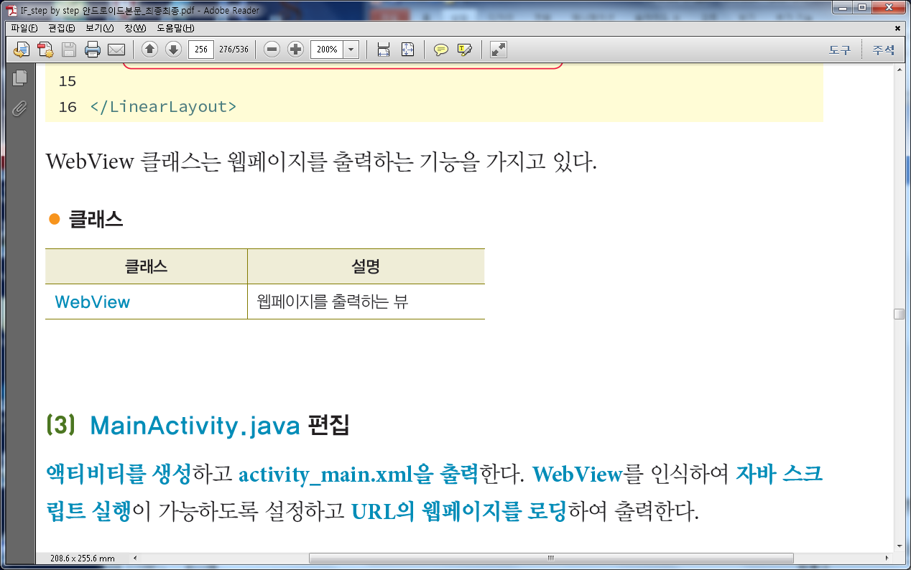
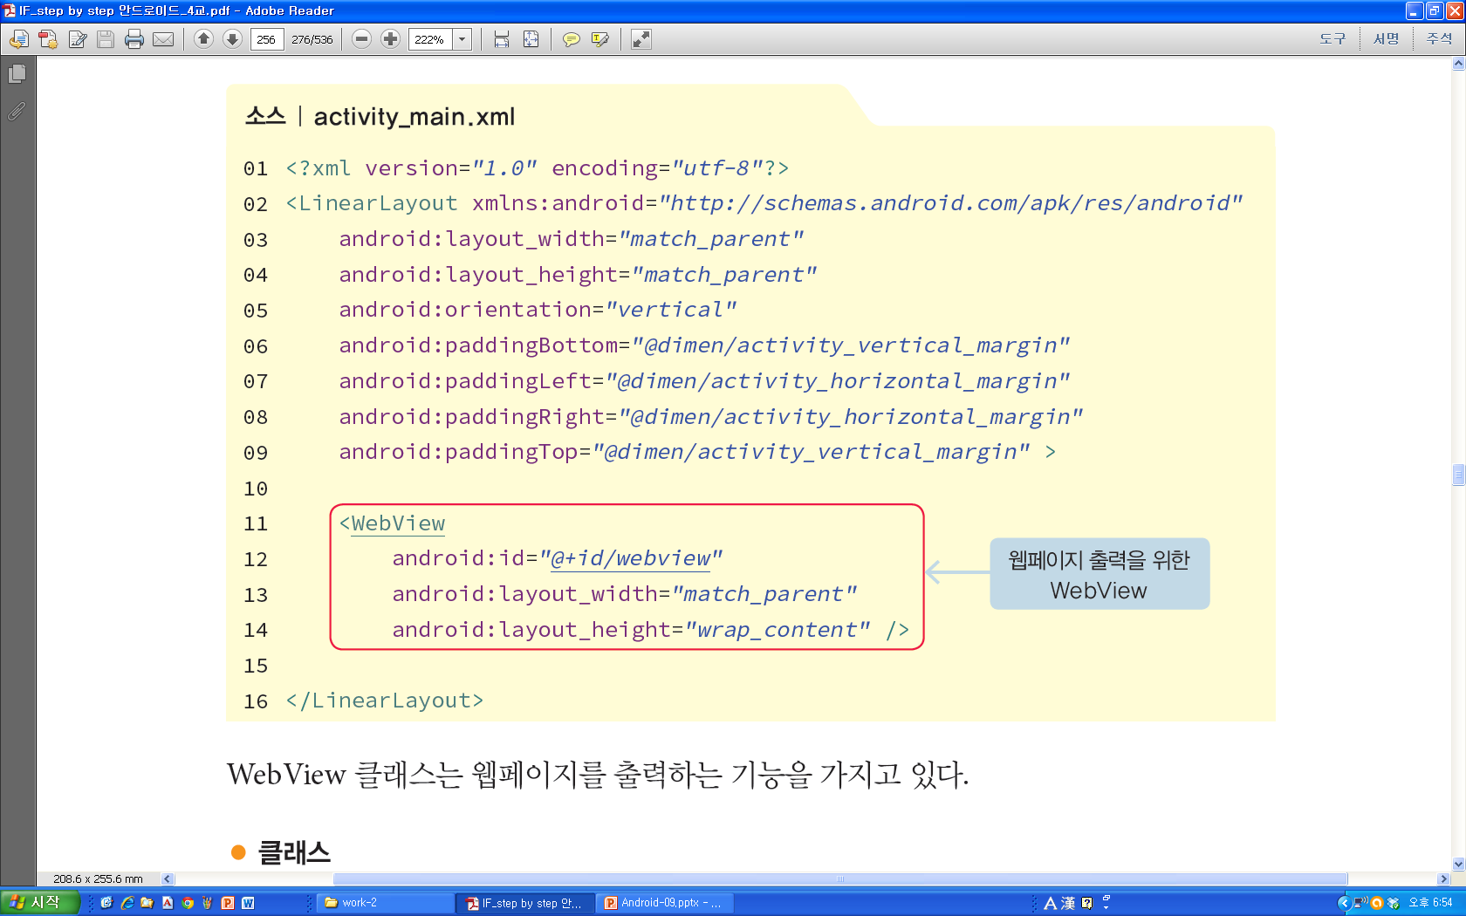
activity_main.xml
○ 웹페이지 출력을 위해 WebView를 사용
○ ID를 webview로 지정

Slide 7
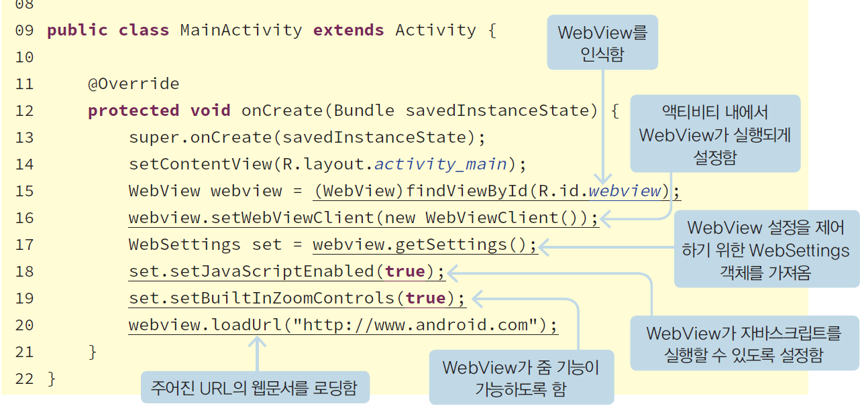
MainActivity.java
○ 액티비티를 생성하고 activity_main.xml을 출력
○ WebView를 인식하여 자바 스크립트 실행이 가능하도록 설정하고 URL의 웹페이지를 로딩하여 출력

Slide 8
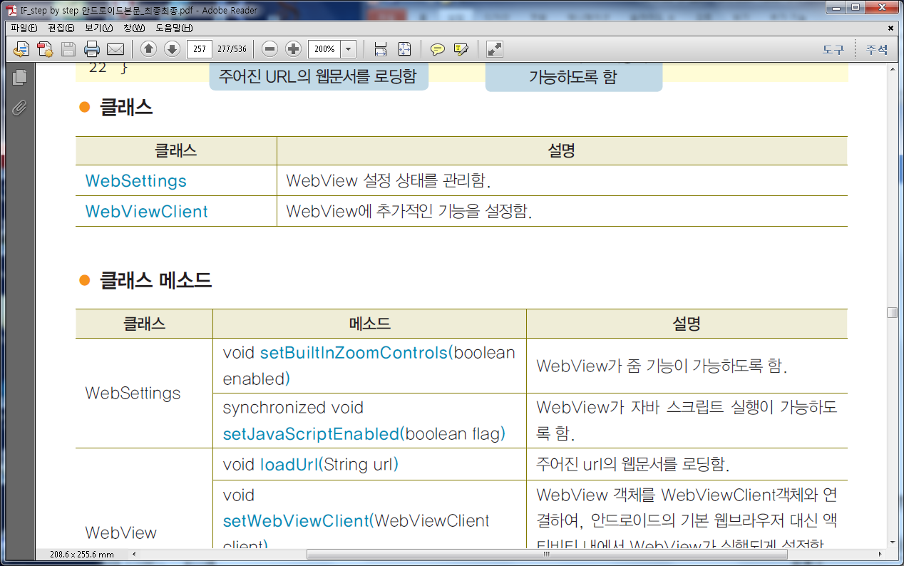
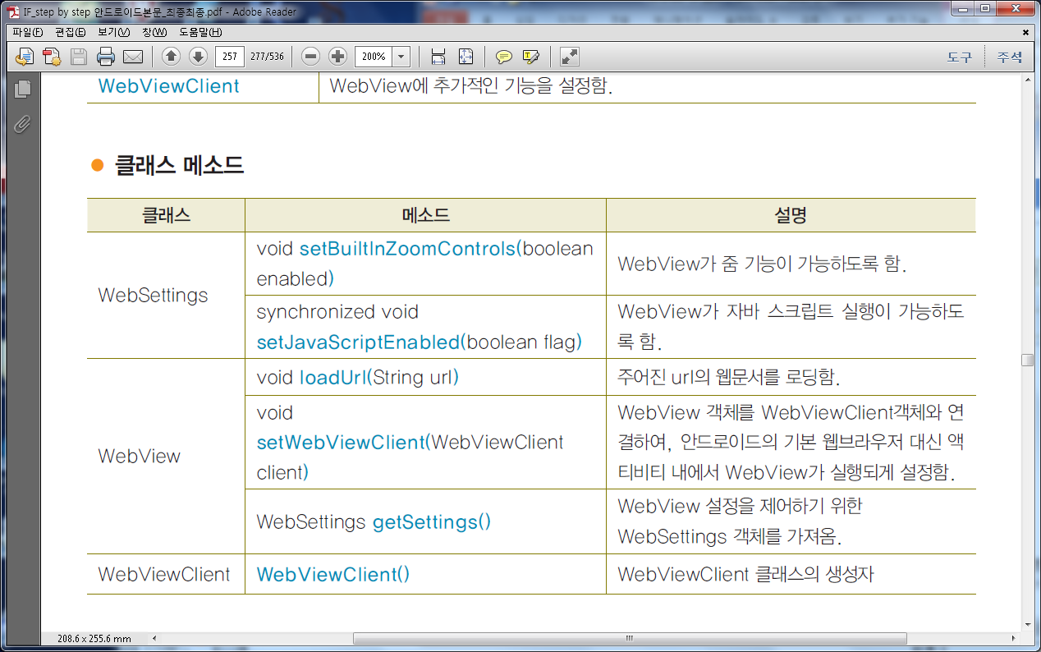
클래스 관련 설명

Slide 9
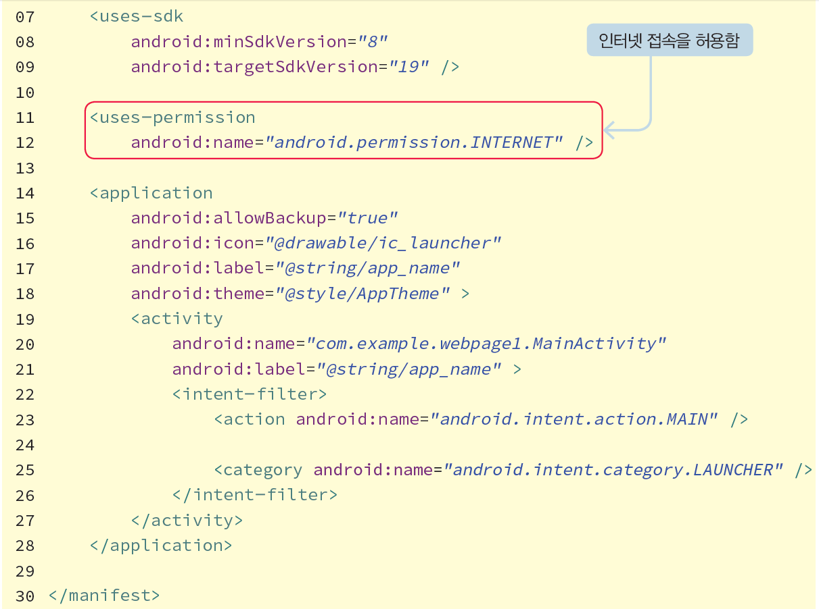
AndroidManifest.xml
웹서버에 접속하기 위해 앱이 인터넷 접속을 허용할 수 있도록 속성 추가

Slide 10
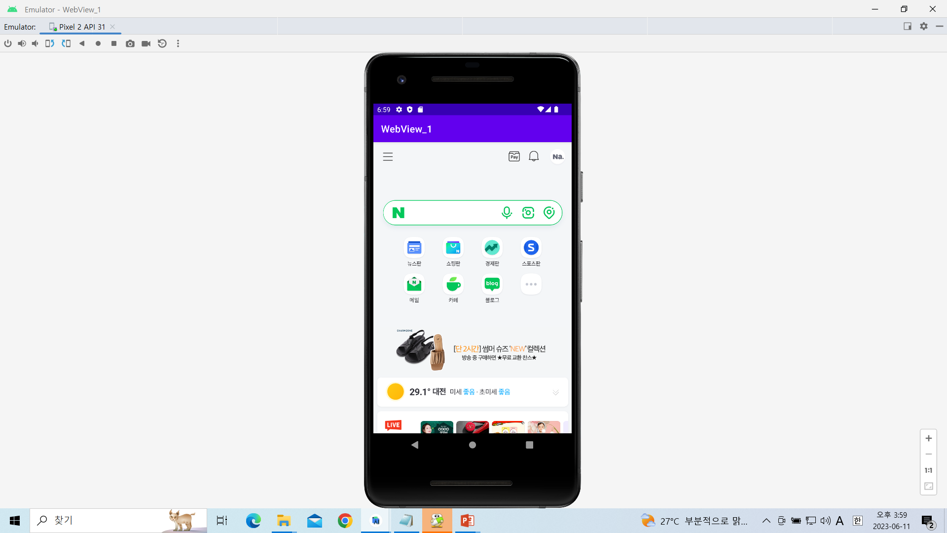
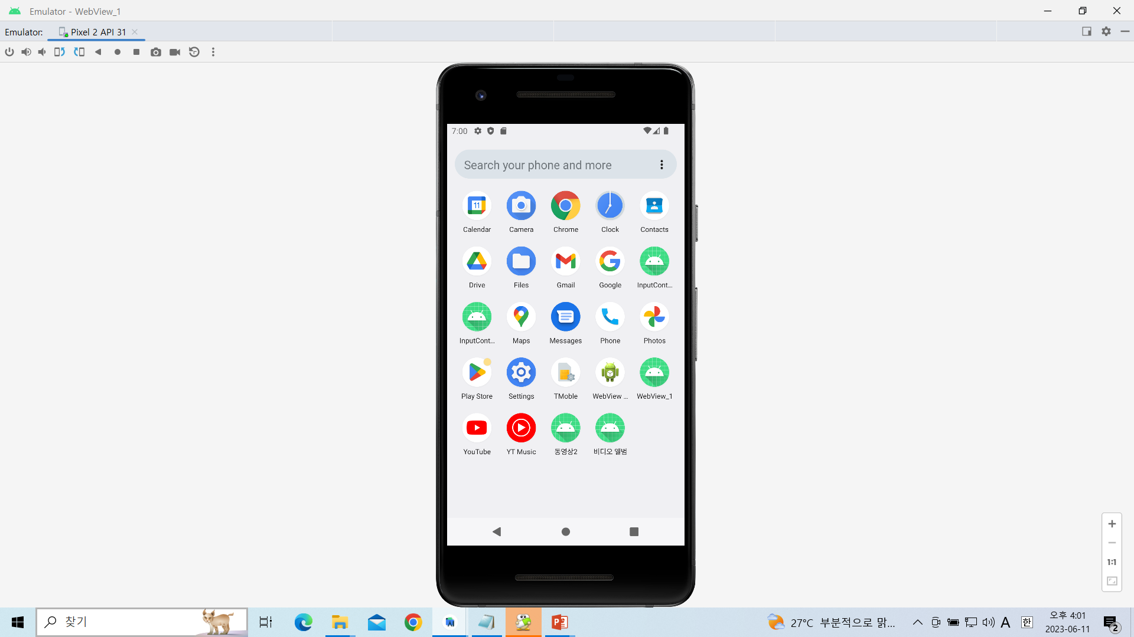
웹뷰를 이용한 웹페이지 출력
WebView1 프로젝트

Slide 11
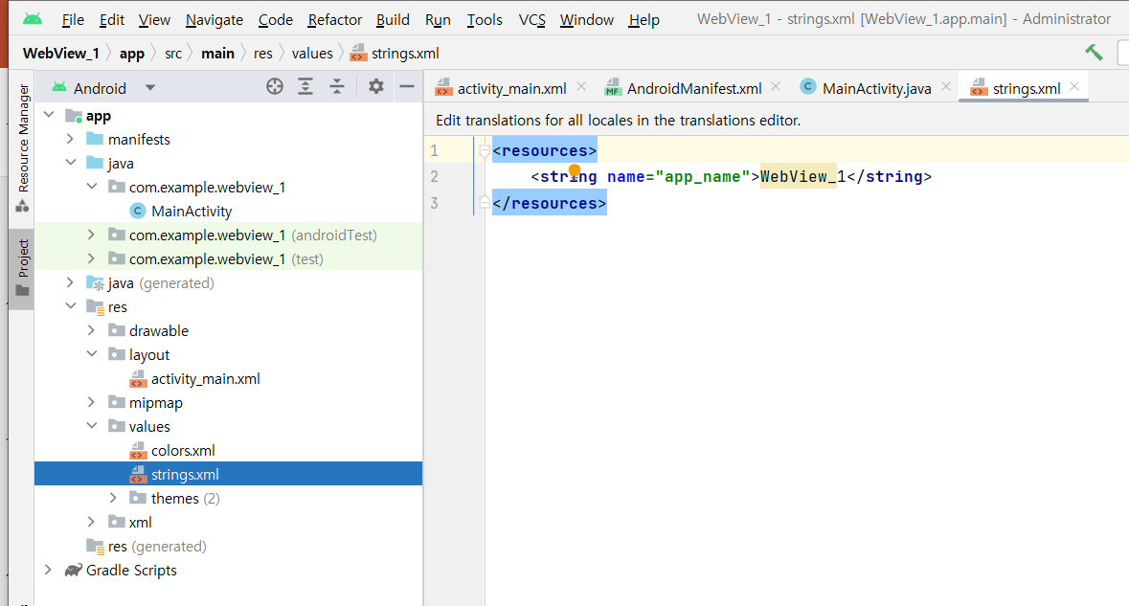
[strings.xml]
<resources>
<string name="app_name">WebView_1</string>
</resources>

Slide 12
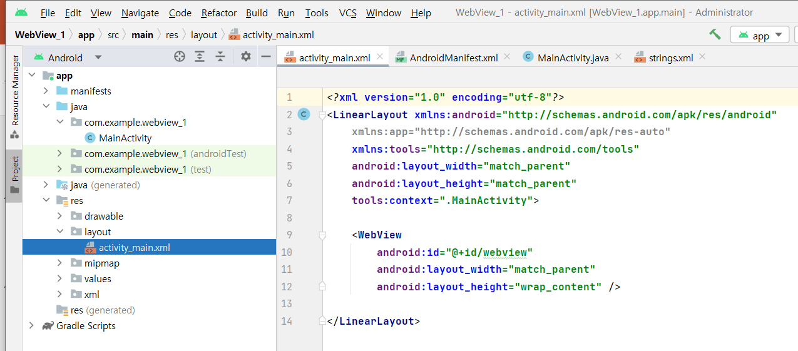
[Activity_main.xml]

Slide 13
<?xml version="1.0" encoding="utf-8"?>
<LinearLayout xmlns:android="http://schemas.android.com/apk/res/android"
xmlns:app="http://schemas.android.com/apk/res-auto"
xmlns:tools="http://schemas.android.com/tools"
android:layout_width="match_parent"
android:layout_height="match_parent"
tools:context=".MainActivity">
<WebView
android:id="@+id/webview"
android:layout_width="match_parent"
android:layout_height="wrap_content" />
</LinearLayout>

Slide 14
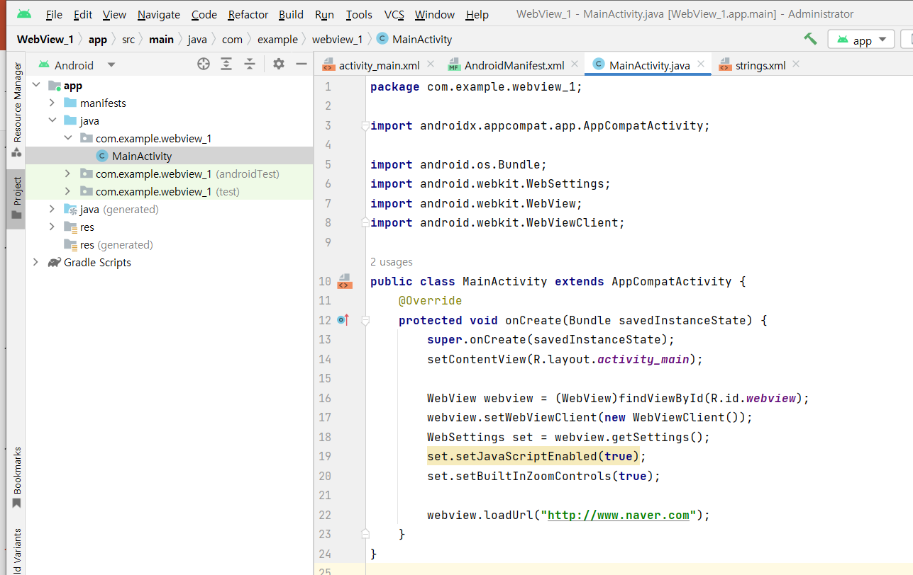
[Mainactivity.java]

Slide 15
package com.example.webview_1;
import androidx.appcompat.app.AppCompatActivity;
import android.os.Bundle;
import android.webkit.WebSettings;
import android.webkit.WebView;
import android.webkit.WebViewClient;
public class MainActivity extends AppCompatActivity {
@Override
protected void onCreate(Bundle savedInstanceState) {
super.onCreate(savedInstanceState);
setContentView(R.layout.activity_main);
WebView webview = (WebView)findViewById(R.id.webview);
webview.setWebViewClient(new WebViewClient());
WebSettings set = webview.getSettings();
set.setJavaScriptEnabled(true);
set.setBuiltInZoomControls(true);
webview.loadUrl("http://www.naver.com");
}
}

Slide 16
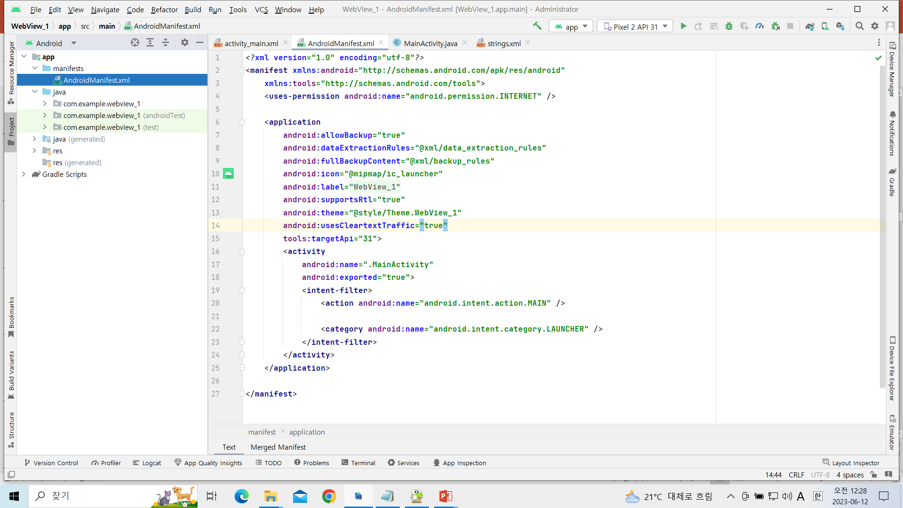
[AndroidManifest.xml]

Slide 17
<?xml version="1.0" encoding="utf-8"?>
<manifest xmlns:android="http://schemas.android.com/apk/res/android"
package="com.example.hybridapp1">
<uses-permission android:name="android.permission.INTERNET" />
<application
android:allowBackup="true"
android:icon="@mipmap/ic_launcher"
android:label="@string/app_name"
android:supportsRtl="true"
android:theme="@style/AppTheme“
android:usesCleartextTraffic="true“
tools:targetApi="31">
<activity android:name=".MainActivity">
<intent-filter>
<action android:name="android.intent.action.MAIN" />
<category android:name="android.intent.category.LAUNCHER" />
</intent-filter>
</activity>
</application>
</manifest>
추가

Slide 18
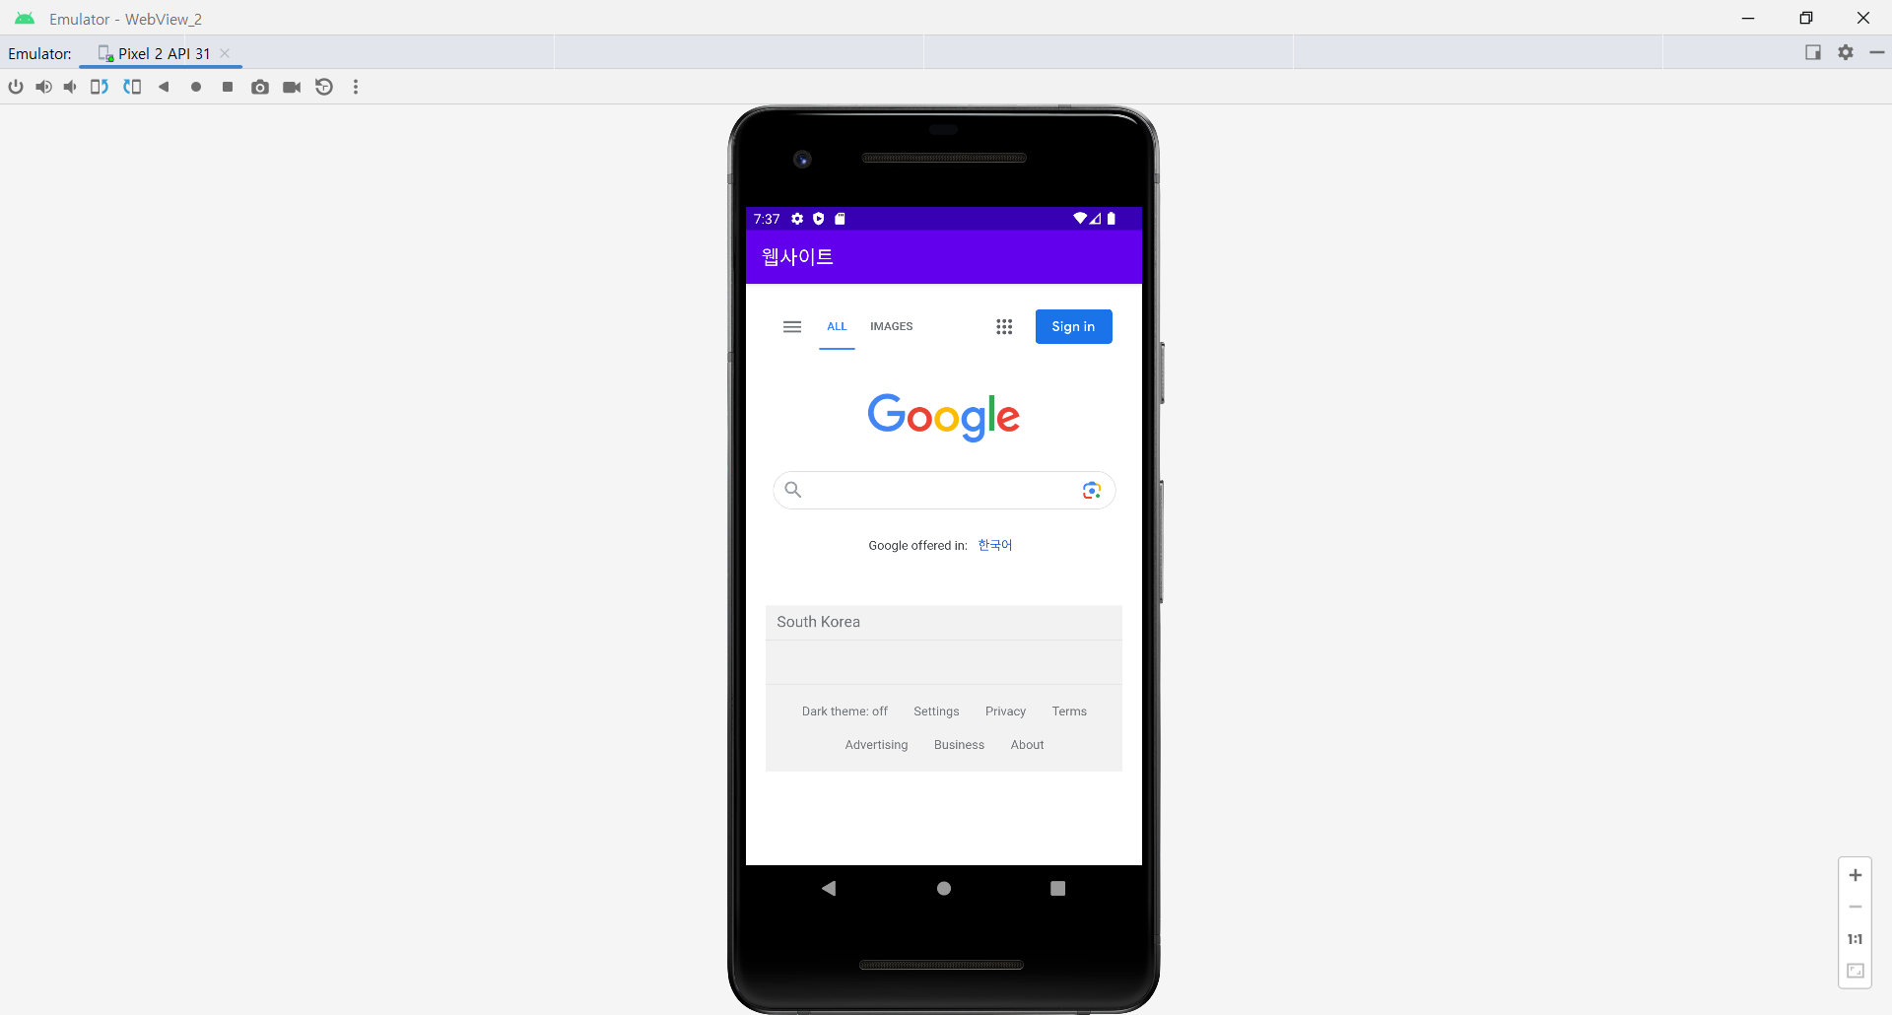
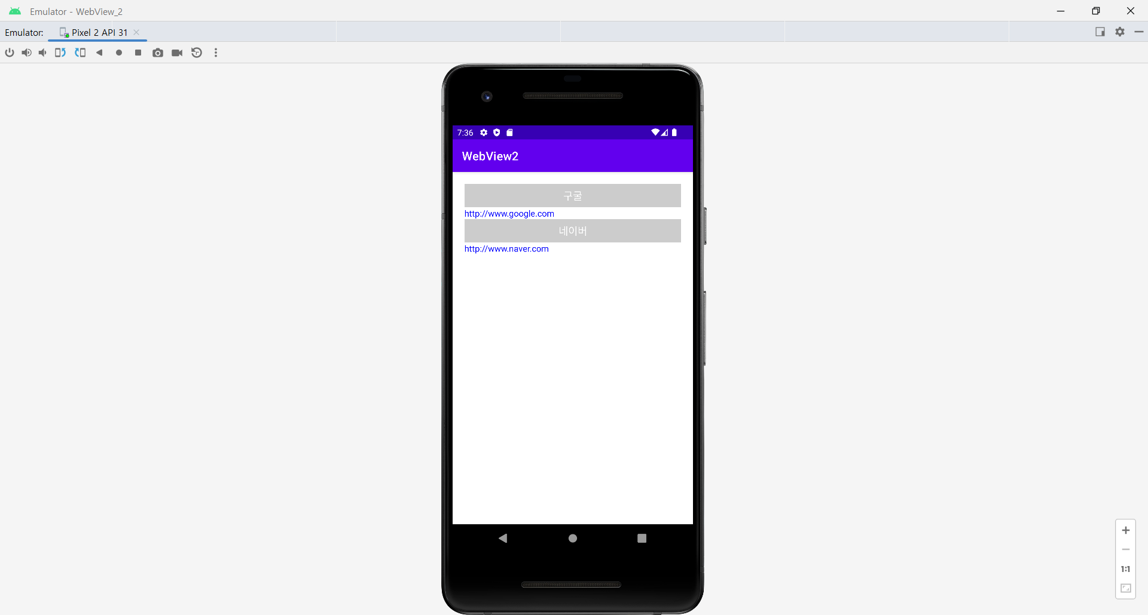
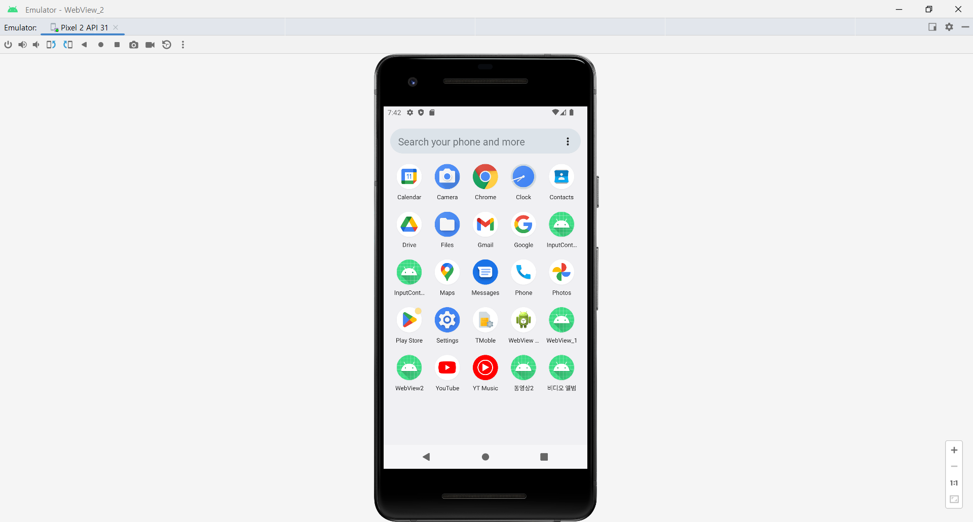
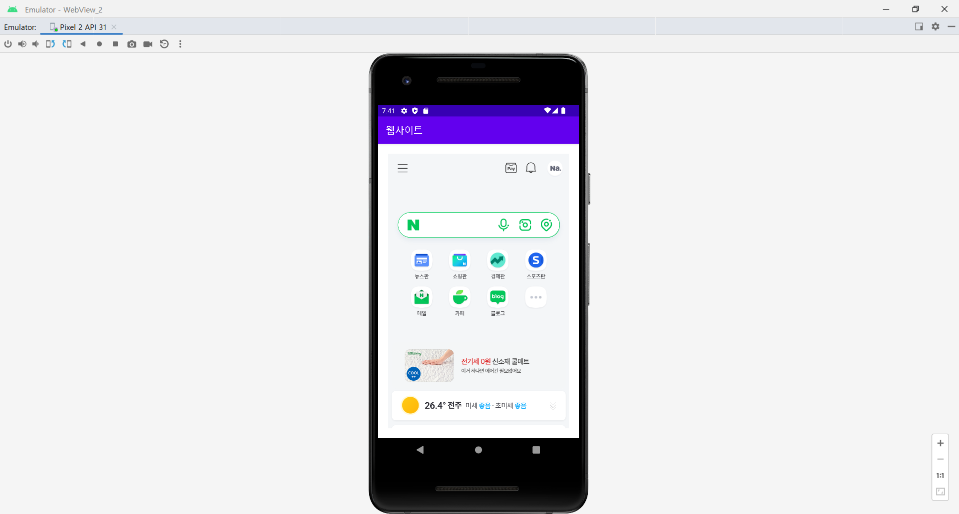
URL주소목록 버튼

Slide 19
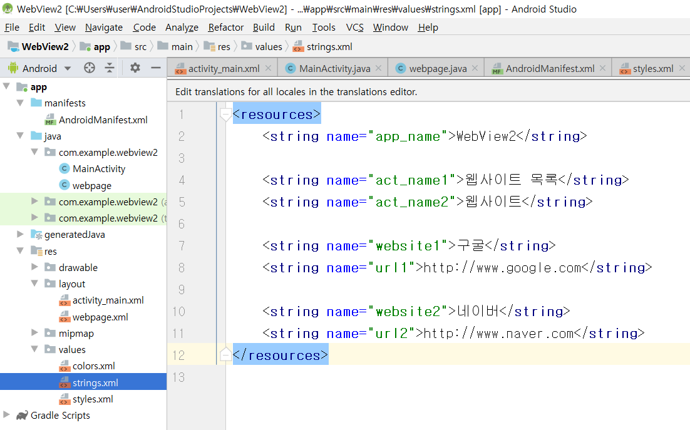
[string.xml]

Slide 20
<resources>
<string name="app_name">WebView2</string>
<string name="act_name1">웹사이트 목록</string>
<string name="act_name2">웹사이트</string>
<string name="website1">구굴</string>
<string name="url1">http://www.google.com</string>
<string name="website2">네이버</string>
<string name="url2">http://www.naver.com</string>
</resources>

Slide 21
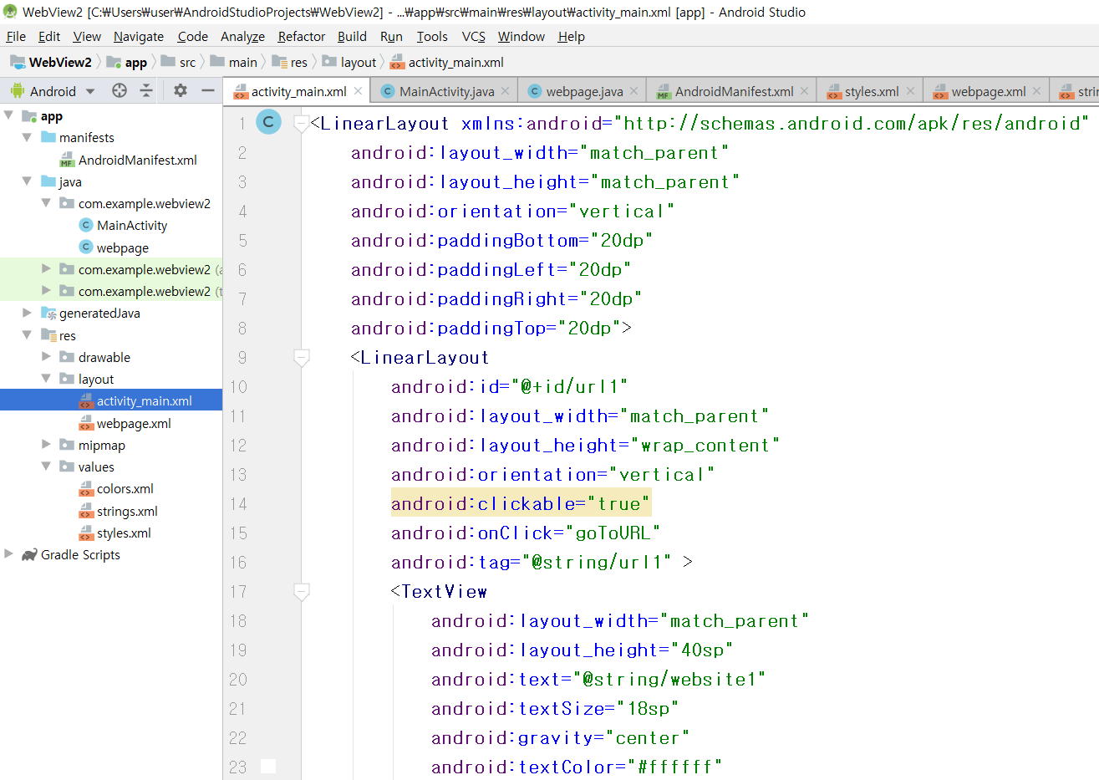
[activity_main.xml]

Slide 22
<LinearLayout xmlns:android="http://schemas.android.com/apk/res/android"
android:layout_width="match_parent"
android:layout_height="match_parent"
android:orientation="vertical"
android:paddingBottom="20dp"
android:paddingLeft="20dp"
android:paddingRight="20dp"
android:paddingTop="20dp">
<LinearLayout
android:id="@+id/url1"
android:layout_width="match_parent"
android:layout_height="wrap_content"
android:orientation="vertical"
android:clickable="true"
android:onClick="goToURL"
android:tag="@string/url1" >
<TextView
android:layout_width="match_parent"
android:layout_height="40sp"
android:text="@string/website1"
android:textSize="18sp"
android:gravity="center"
android:textColor="#ffffff"
android:background="#33000000" />
<TextView
android:layout_width="wrap_content"
android:layout_height="wrap_content"
android:text="@string/url1"
android:textSize="15sp"
android:textColor="#0000ff" />
</LinearLayout>

Slide 23
<LinearLayout
android:id="@+id/url2"
android:layout_width="match_parent"
android:layout_height="wrap_content"
android:orientation="vertical"
android:clickable="true"
android:onClick="goToURL"
android:tag="@string/url2" >
<TextView
android:layout_width="match_parent"
android:layout_height="40sp"
android:text="@string/website2"
android:textSize="18sp"
android:gravity="center"
android:textColor="#ffffff"
android:background="#33000000" />
<TextView
android:layout_width="wrap_content"
android:layout_height="wrap_content"
android:text="@string/url2"
android:textSize="15sp"
android:textColor="#0000ff" />
</LinearLayout>
</LinearLayout>

Slide 24
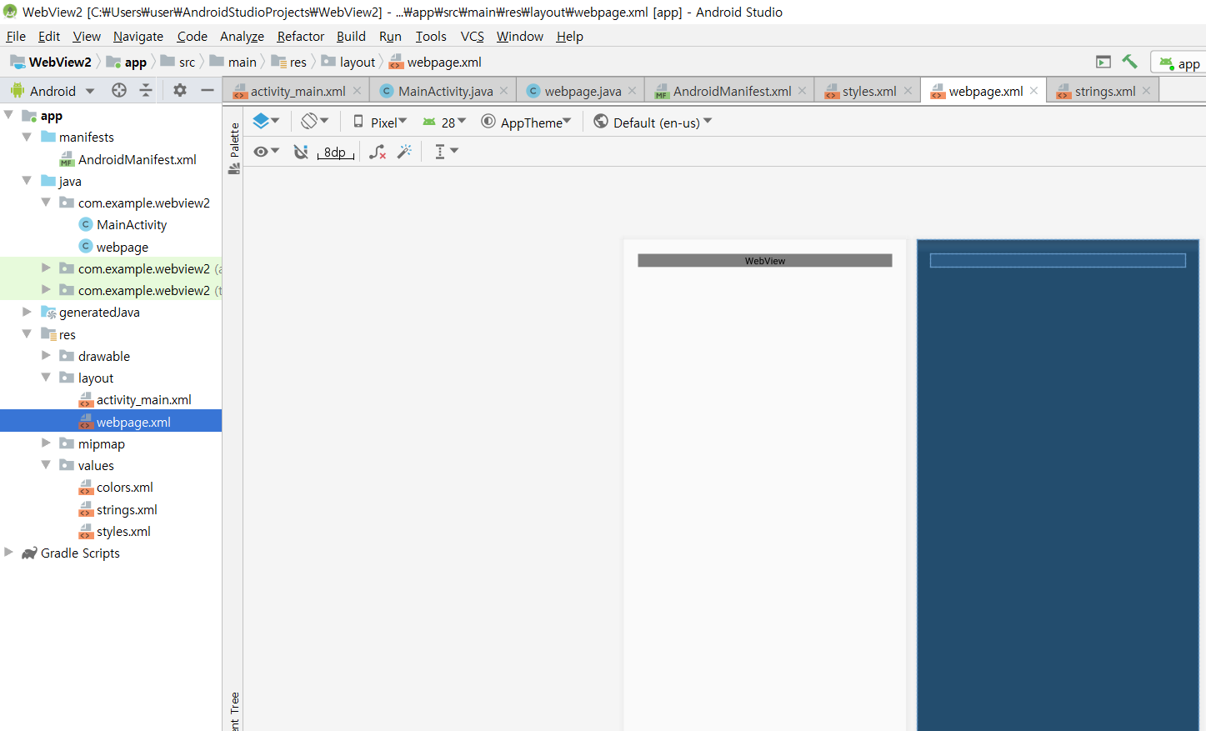
[webpage.xml]

Slide 25
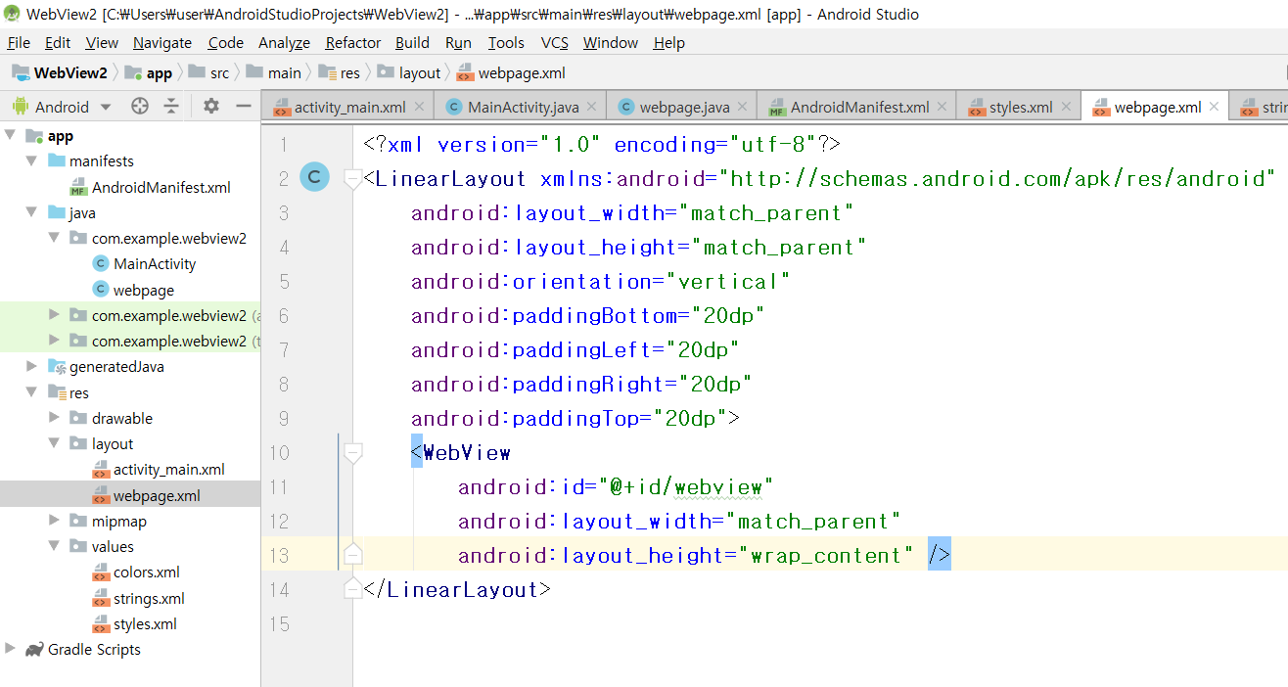

Slide 26
<?xml version="1.0" encoding="utf-8"?>
<LinearLayout xmlns:android="http://schemas.android.com/apk/res/android"
android:layout_width="match_parent"
android:layout_height="match_parent"
android:orientation="vertical"
android:paddingBottom="20dp"
android:paddingLeft="20dp"
android:paddingRight="20dp"
android:paddingTop="20dp">
<WebView
android:id="@+id/webview"
android:layout_width="match_parent"
android:layout_height="wrap_content" />
</LinearLayout>

Slide 27
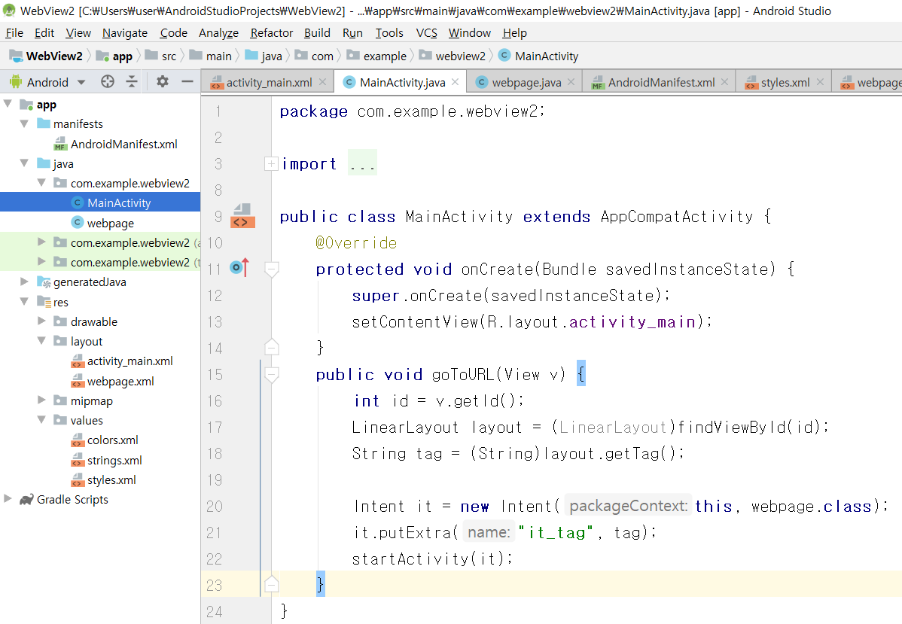
[Mainactivity.java]

Slide 28
package com.example.webview_2;
import androidx.appcompat.app.AppCompatActivity;
import android.content.Intent;
import android.os.Bundle;
import android.view.View;
import android.widget.LinearLayout;
public class MainActivity extends AppCompatActivity {
@Override
protected void onCreate(Bundle savedInstanceState) {
super.onCreate(savedInstanceState);
setContentView(R.layout.activity_main);
}
public void goToURL(View v) {
int id = v.getId();
LinearLayout layout = (LinearLayout)findViewById(id);
String tag = (String)layout.getTag();
Intent it = new Intent(this, webpage.class);
it.putExtra("it_tag", tag);
startActivity(it);
}
}

Slide 29
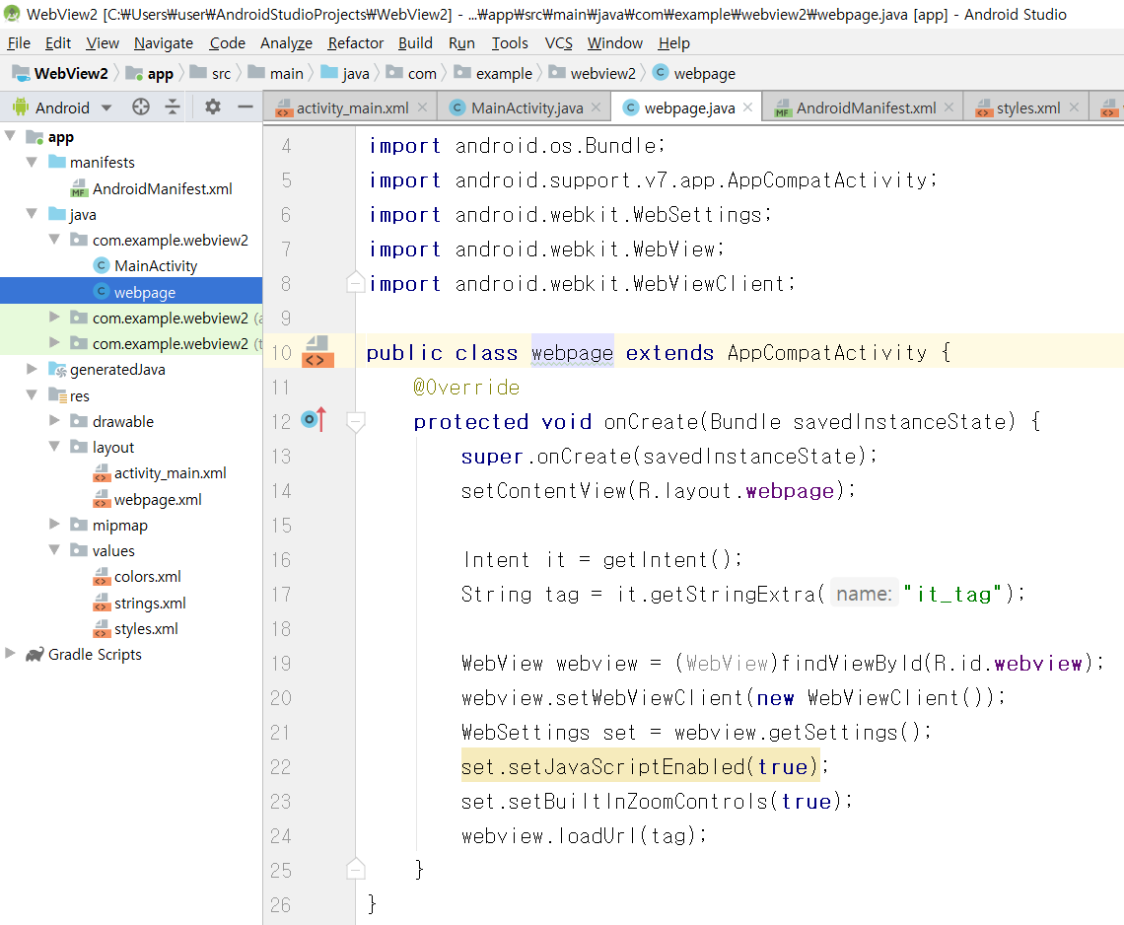
[WebPage.java]

Slide 30
package com.example.webview_2;
import android.content.Intent;
import android.os.Bundle;
import android.webkit.WebSettings;
import android.webkit.WebView;
import android.webkit.WebViewClient;
import androidx.appcompat.app.AppCompatActivity;
public class webpage extends AppCompatActivity {
@Override
protected void onCreate(Bundle savedInstanceState) {
super.onCreate(savedInstanceState);
setContentView(R.layout.webpage);
Intent it = getIntent();
String tag = it.getStringExtra("it_tag");
WebView webview = (WebView)findViewById(R.id.webview);
webview.setWebViewClient(new WebViewClient());
WebSettings set = webview.getSettings();
set.setJavaScriptEnabled(true);
set.setBuiltInZoomControls(true);
webview.loadUrl(tag);
}
}

Slide 31
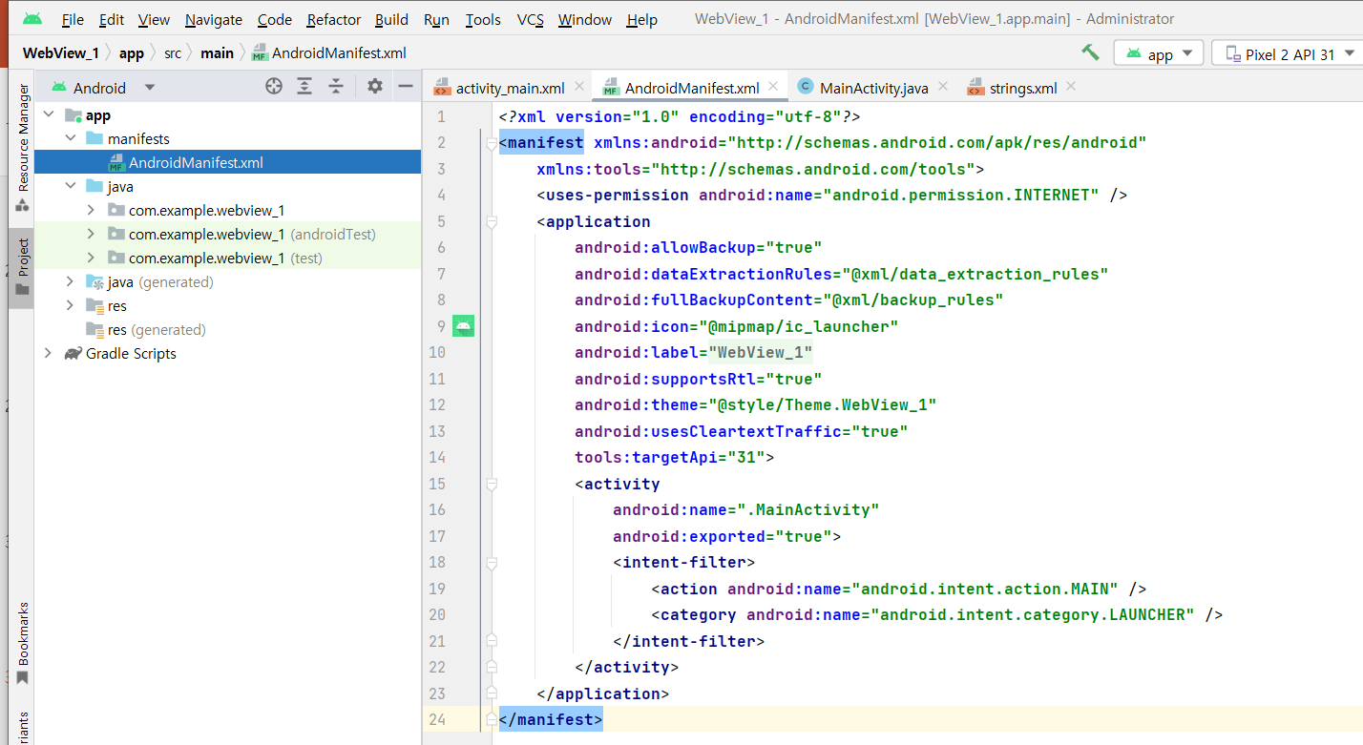
[AndroidManifest.xml]

Slide 32
<?xml version="1.0" encoding="utf-8"?>
<manifest xmlns:android="http://schemas.android.com/apk/res/android"
package="com.example.webview2">
<uses-permission android:name="android.permission.INTERNET" />
<application
android:allowBackup="true"
android:icon="@mipmap/ic_launcher"
android:label="@string/app_name"
android:roundIcon="@mipmap/ic_launcher_round"
android:supportsRtl="true"
android:theme="@style/AppTheme"
android:usesCleartextTraffic="true"
tools:targetApi="31">
<activity android:name=".MainActivity">
<intent-filter>
<action android:name="android.intent.action.MAIN" />
<category android:name="android.intent.category.LAUNCHER" />
</intent-filter>
</activity>
<activity
android:name=".webpage"
android:label="@string/act_name2" >
</activity>
</application>
</manifest>

Slide 33
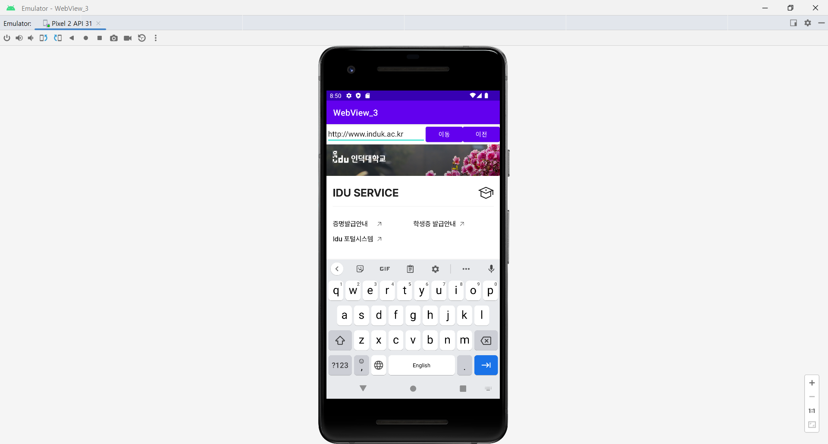
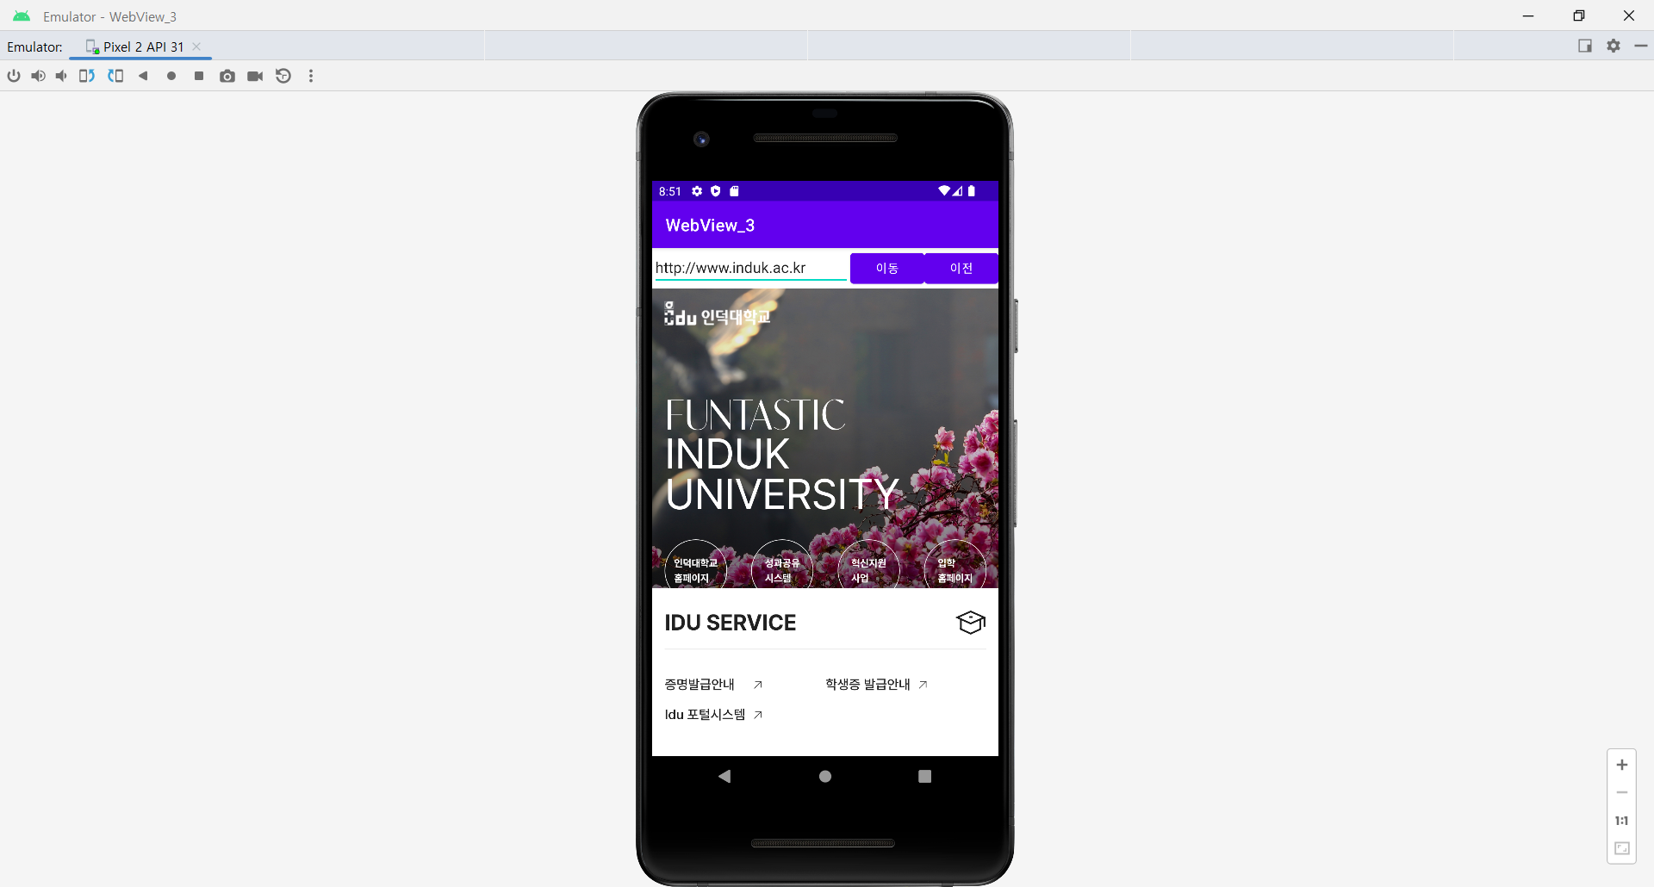
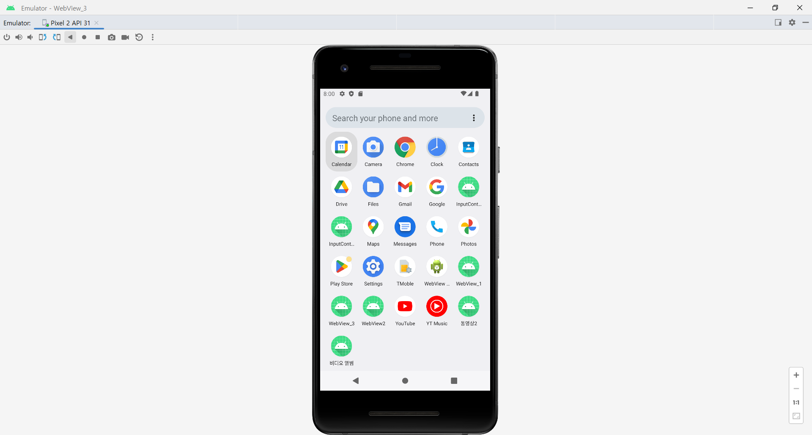
URL창에 주소 입력-1

Slide 34
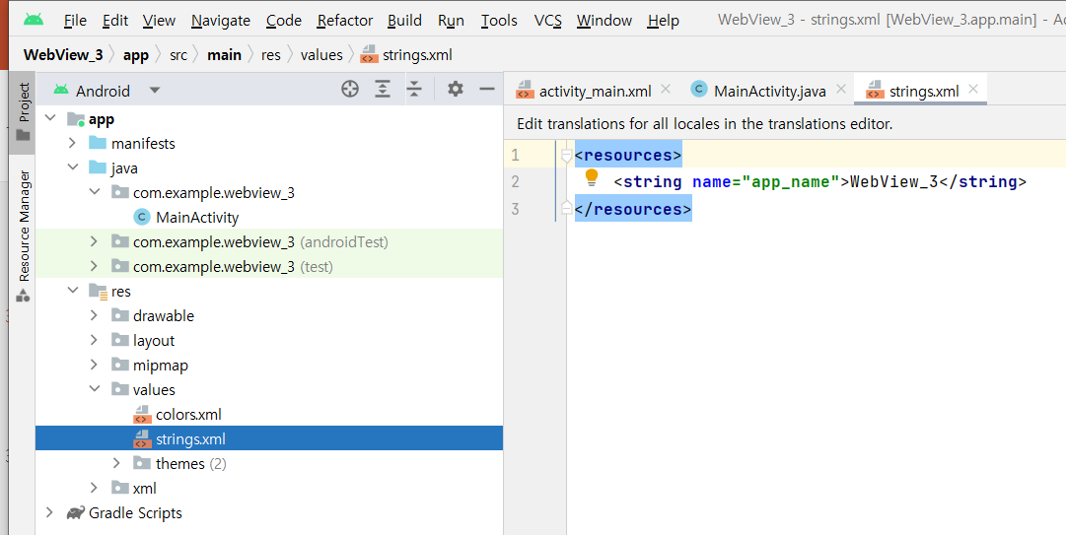
[string.xml]
<resources>
<string name="app_name">WebView3</string>
</resources>

Slide 35
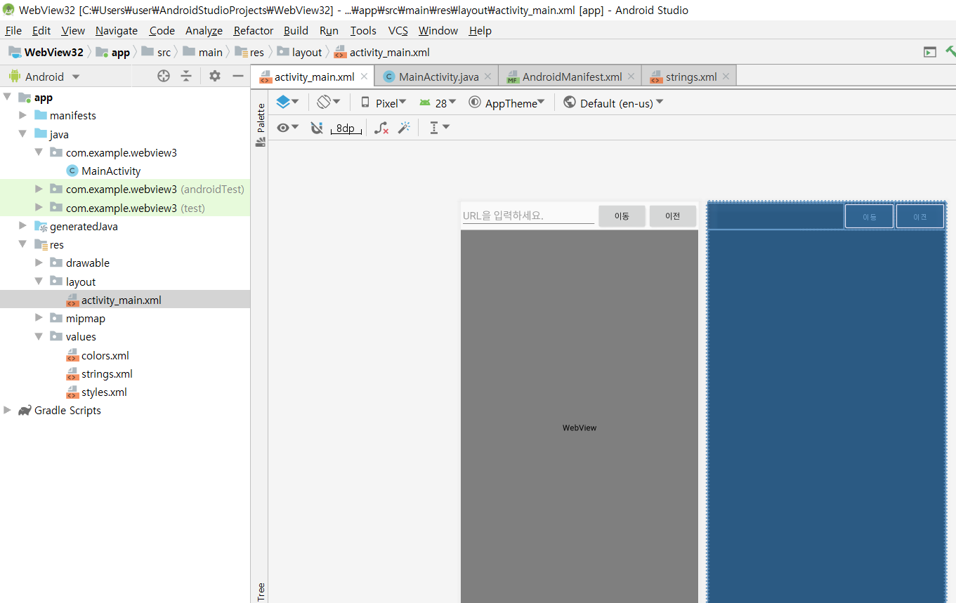
[activity_main.xml]

Slide 36
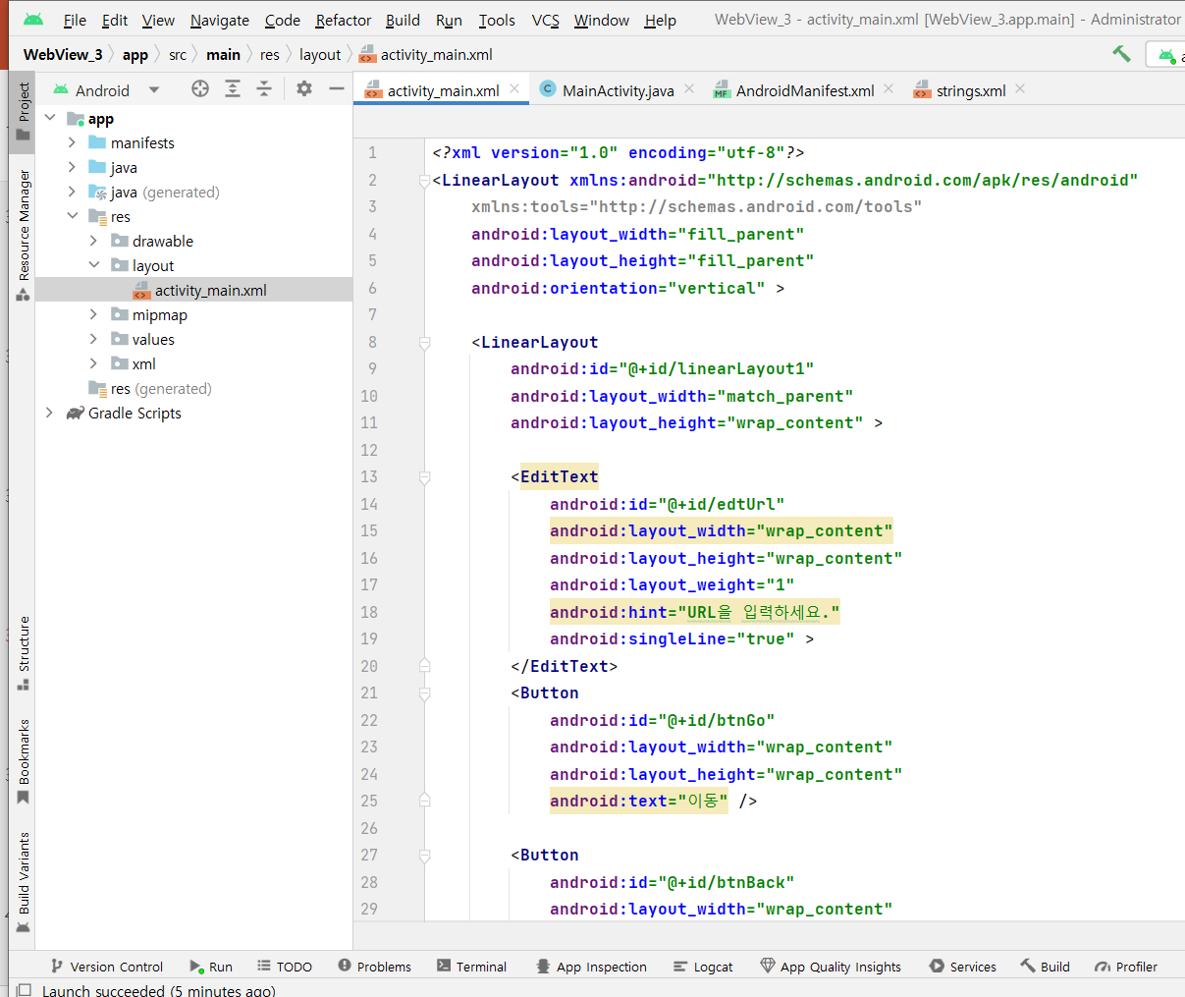

Slide 37
<?xml version="1.0" encoding="utf-8"?>
<LinearLayout xmlns:android="http://schemas.android.com/apk/res/android"
xmlns:tools="http://schemas.android.com/tools"
android:layout_width="fill_parent"
android:layout_height="fill_parent"
android:orientation="vertical" >
<LinearLayout
android:id="@+id/linearLayout1"
android:layout_width="match_parent"
android:layout_height="wrap_content" >
<EditText
android:id="@+id/edtUrl"
android:layout_width="wrap_content"
android:layout_height="wrap_content"
android:layout_weight="1"
android:hint="URL을 입력하세요."
android:singleLine="true" >
</EditText>

Slide 38
<Button
android:id="@+id/btnGo"
android:layout_width="wrap_content"
android:layout_height="wrap_content"
android:text="이동" />
<Button
android:id="@+id/btnBack"
android:layout_width="wrap_content"
android:layout_height="wrap_content"
android:text="이전" />
</LinearLayout>
<WebView
android:id="@+id/webView1"
android:layout_width="match_parent"
android:layout_height="match_parent"
android:clickable="true" />
</LinearLayout>

Slide 39
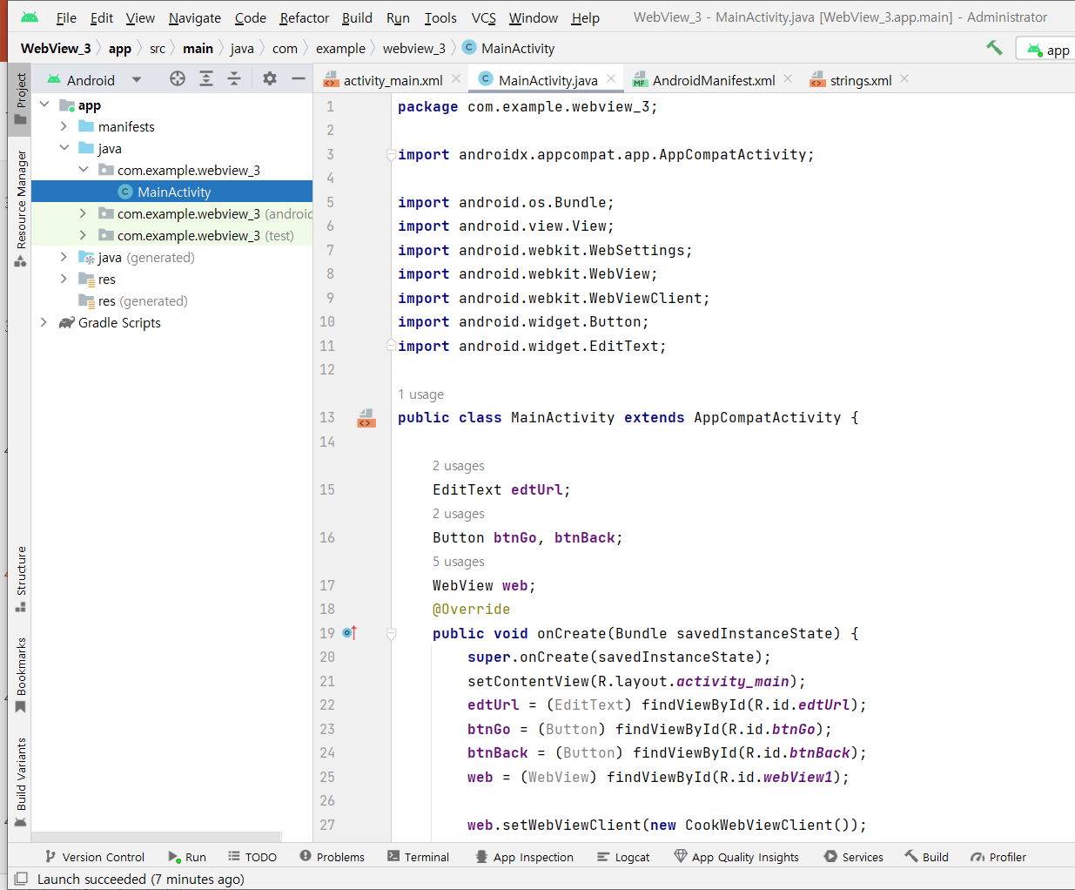
[MainActivity.java]

Slide 40
package com.example.webview_3;
import androidx.appcompat.app.AppCompatActivity;
import android.os.Bundle;
import android.view.View;
import android.webkit.WebSettings;
import android.webkit.WebView;
import android.webkit.WebViewClient;
import android.widget.Button;
import android.widget.EditText;
public class MainActivity extends AppCompatActivity {
EditText edtUrl;
Button btnGo, btnBack;
WebView web;
@Override
public void onCreate(Bundle savedInstanceState) {
super.onCreate(savedInstanceState);
setContentView(R.layout.activity_main);

Slide 41
edtUrl = (EditText) findViewById(R.id.edtUrl);
btnGo = (Button) findViewById(R.id.btnGo);
btnBack = (Button) findViewById(R.id.btnBack);
web = (WebView) findViewById(R.id.webView1);
web.setWebViewClient(new CookWebViewClient());
WebSettings webSet = web.getSettings();
webSet.setBuiltInZoomControls(true);
btnGo.setOnClickListener(new View.OnClickListener() {
public void onClick(View v) {
web.loadUrl(edtUrl.getText().toString());
}
});
btnBack.setOnClickListener(new View.OnClickListener() {
public void onClick(View v) {
web.goBack();
}
});
}

Slide 42
private class CookWebViewClient extends WebViewClient {
@Override
public boolean shouldOverrideUrlLoading(WebView view, String url) {
view.loadUrl(url);
return true;
}
}
}

Slide 43
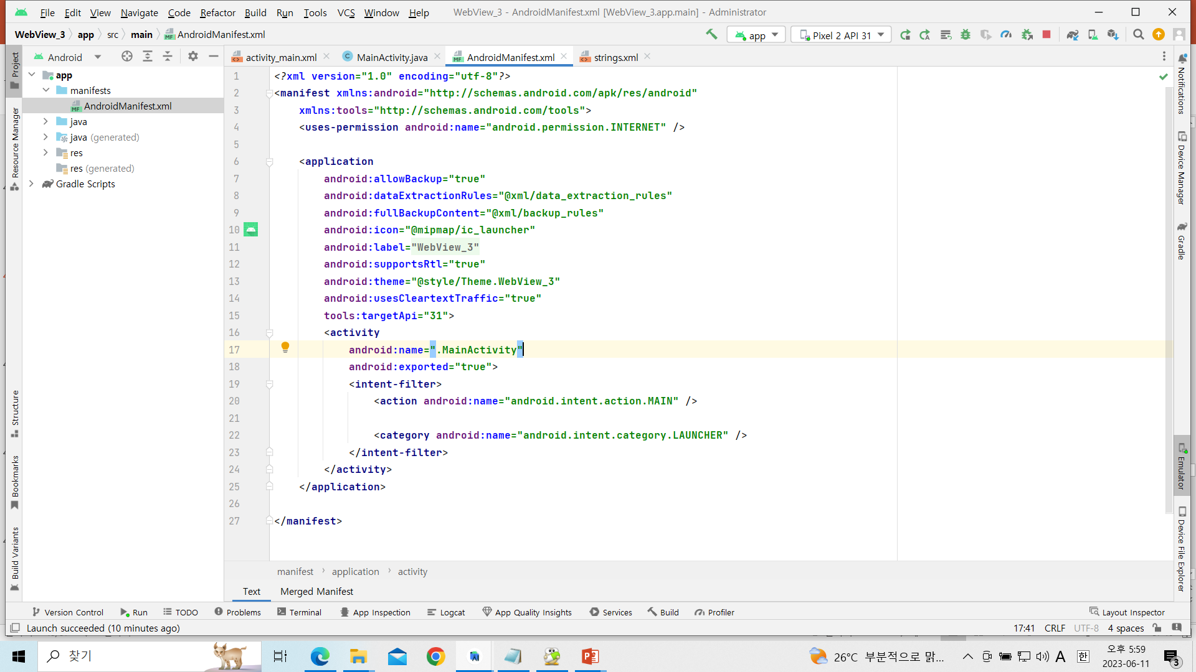
[AndroidManifest.xml]

Slide 44
<?xml version="1.0" encoding="utf-8"?>
<manifest xmlns:android="http://schemas.android.com/apk/res/android"
package="com.example.webview3">
<uses-permission android:name="android.permission.INTERNET" />
<application
android:allowBackup="true"
android:icon="@mipmap/ic_launcher"
android:label="@string/app_name"
android:roundIcon="@mipmap/ic_launcher_round"
android:supportsRtl="true"
android:theme="@style/AppTheme"
android:usesCleartextTraffic="true“
tools:targetApi="31">
<activity android:name=".MainActivity">
<intent-filter>
<action android:name="android.intent.action.MAIN" />
<category android:name="android.intent.category.LAUNCHER" />
</intent-filter>
</activity>
</application>

